Slide 1
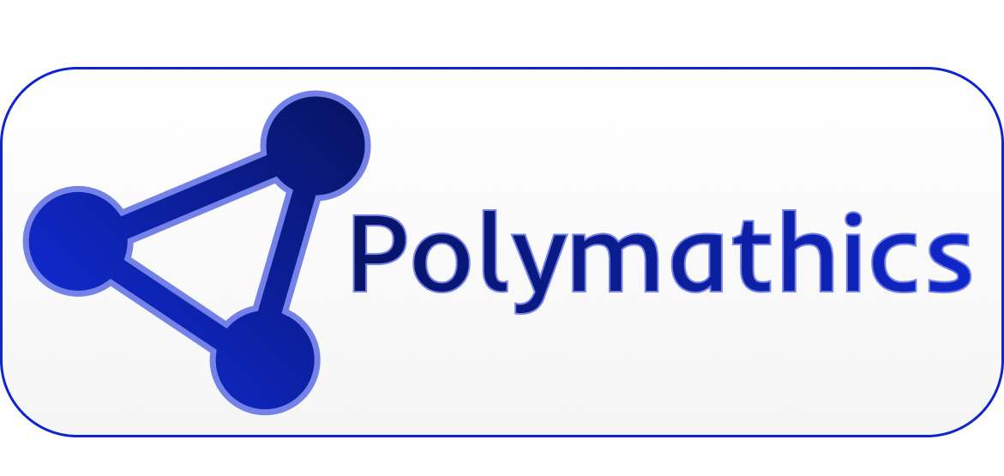
AI-Powered Automation for Modern Business
Construction Use Cases
AI Automation Solutions • 2026
Confidential | polymathics.ai

Slide 2
Agenda
01
02
03
04
Dynamic Project Dashboard
Estimate from Bid Documents
Bid-to-Gantt Automation
Business Impact
Real-time visibility across all active projects
AI-powered quantity takeoffs in minutes
Convert requirements into project schedules instantly
ROI metrics across all three automation use cases
Polymathics | Confidential

Slide 3

USE CASE
Automated project visibility
01
AI aggregates data from multiple sources to deliver real-time dashboards — no manual updates needed.
Dynamic Project Dashboard
Polymathics | Confidential

Slide 4
The Challenge: Fragmented Project Data
Key Pain Points for Construction Project Managers
• Scattered data: Project updates live in emails, spreadsheets, and disconnected apps
• Manual reporting: PMs spend 5–10 hours/week compiling status reports by hand
• No real-time visibility: Leadership lacks live insight into schedule, budget, and risk
• Delayed decisions: Issues surface late due to lagging, fragmented reporting
Polymathics | Confidential

Slide 5
Solution: Dynamic Project Dashboard
Dashboard Modules
How Polymathics Powers It
• Schedule Tracker: Live Gantt view across all active projects
• Budget Monitor: Real-time cost vs. forecast with variance alerts
• Risk Log: Auto-prioritized issues and blockers by severity
• Subcontractor Status: Daily progress updates pulled automatically
Our AI connects to your existing project management tools (Procore, Buildertrend, MS Project) and automatically pulls, normalizes, and visualizes data in a single live dashboard — updated every hour without any manual input.
Polymathics | Confidential

Slide 6
USE CASE
AI-powered estimation
02
Upload bid documents and let AI extract quantities, materials, and labor costs — delivering a complete estimate in minutes, not days.
Estimate from Bid Documents
Polymathics | Confidential

Slide 7
AI-Powered Bid Document Analysis
How the Estimation Process Works
• Step 1 — Upload: Drop in bid documents (PDF, Excel, CAD) into the Polymathics portal
• Step 2 — Extract: AI reads and parses scope of work, specs, and quantity tables automatically
• Step 3 — Estimate: Labor, materials, and equipment costs are calculated using live price databases
• Step 4 — Export: Receive a structured estimate in Excel or your estimating software format
Polymathics | Confidential

Slide 8
Before & After: The Estimation Process
Traditional Process
With Polymathics AI
• 2–5 days of manual document review per bid
• Risk of human error in quantity takeoffs
• Estimators pulled away from higher-value work
• Inconsistent formats across bids and projects
Estimates are generated in under 30 minutes with 95%+ accuracy. Estimators review and adjust rather than build from scratch — freeing them to focus on strategy, client relationships, and winning more bids.
Polymathics | Confidential

Slide 9
USE CASE
Automated project scheduling
03
Convert bid requirements and project scope directly into detailed, phased Gantt charts — ready to share with your team in minutes.
Bid-to-Gantt Automation
Polymathics | Confidential

Slide 10
From Bid Requirements to Gantt Chart
The Automation Workflow
• Input: Provide bid documents, scope of work, or a project requirements brief
• Parse: AI identifies all project phases, tasks, dependencies, and durations
• Generate: A fully structured Gantt chart is created with realistic timelines and milestones
• Export: Download as MS Project, Excel, or Procore-compatible format for immediate use
Polymathics | Confidential

Slide 11
Business Impact
ROI Across Construction Automation
70%
$2M+
3x
Faster Estimating
Avg. Annual Savings
Faster Scheduling
Reduce manual takeoff time from days to hours
Per mid-sized GC adopting AI estimation
Project schedules generated in minutes vs. days
Polymathics | Confidential

Slide 12
Thank You
Empowering businesses with intelligent AI automation
Dag Farias | dagfarias@polymathicsai.com | 917-916-5299
www.polymathicsai.com
© 2026 Polymathics. All rights reserved.

